Slide 1
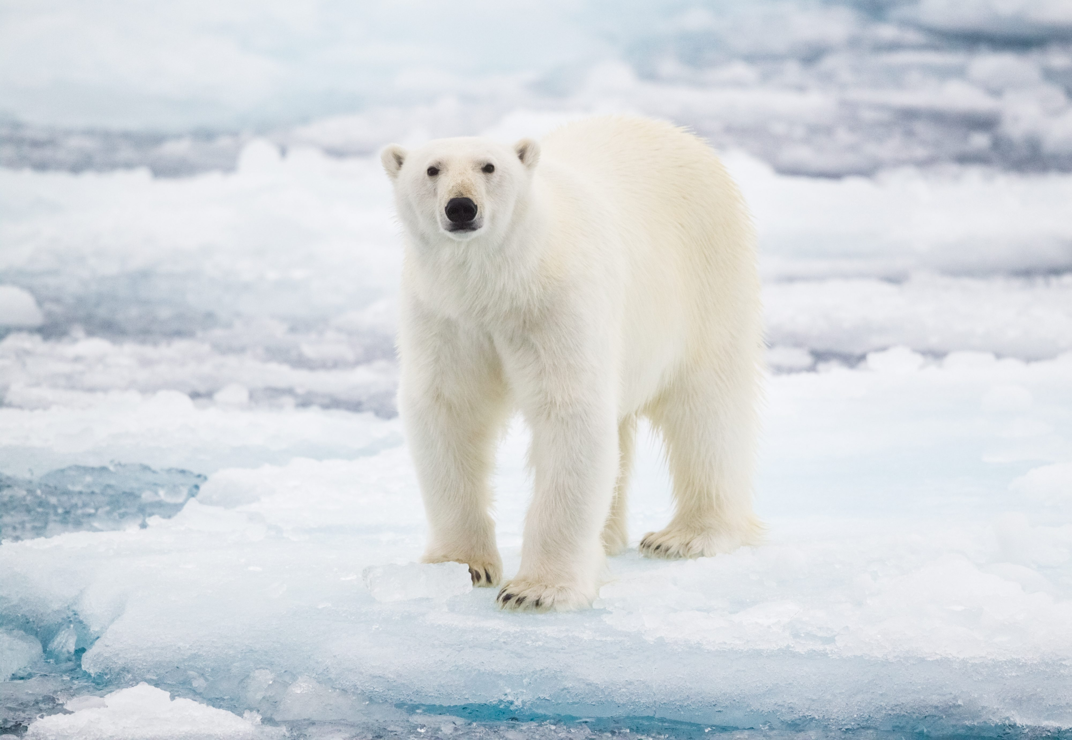
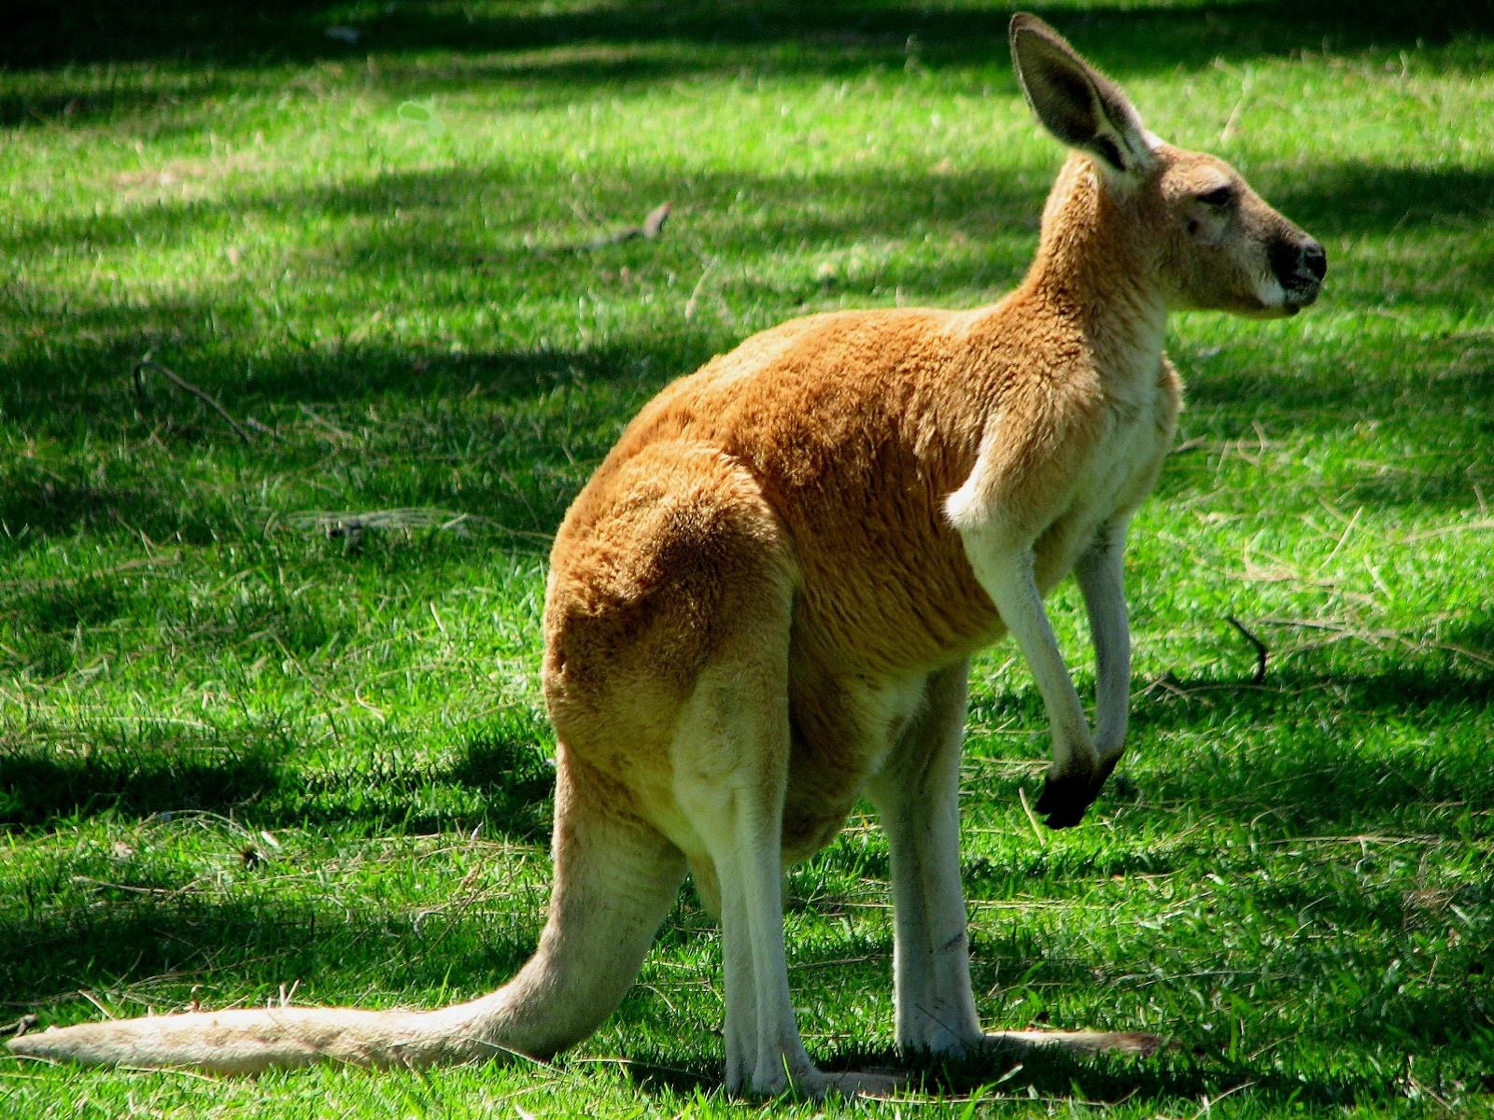
Habitats – Page 1
In the following passage, underline or highlight all the key-words and information. Then, answer the questions on the back
Animals need habitats to live in because it gives them a safe and comfortable home. A habitat is a place where an animal can find food, water, shelter and a good place to raise its young. Animals have adapted to their habitat to survive, for example, a polar bear has thick fur to keep it warm in the cold Arctic, and a cactus has spikes to protect it from predators and to store water in the hot desert. If habitats are destroyed or changed, animals may not be able to find the resources they need to live and their survival can be at risk.
Kangaroos live in habitats called savannas, which are found in Australia. Savannas are open grassy areas with scattered trees and are usually hot and dry. Kangaroos have adapted to this environment by having strong hind legs, which allow them to hop quickly over long distances in search of food and water.
Non-living things, like rocks, water, and air, also play an important role in habitats. Rocks provide a place for animals to rest, sunbathe, and hide from predators. Water is essential for all living things, and habitats that have access to water support a greater diversity of plant and animal life. Air provides animals with oxygen to breathe, and weather patterns in a habitat can affect the types of plants and animals that can survive there. Non-living things also influence the geography and structure of a habitat. For example, mountains and valleys can create different microclimates and ecosystems within a larger habitat. Overall, non-living things are an important component of habitats, and the interaction between living and non-living things creates a complex and dynamic ecosystem.

Slide 2
Habitats – Page 2
Why do animals need habitats?
______________________________________________________________________
What are the four things an animal needs to find in their habitat?
__________________________________________________________
__________________________________________________________
__________________________________________________________
__________________________________________________________
What happens to animals if their habitats are destroyed or changed?
______________________________________________________________________
What is the habitat of kangaroos called and where is it found?
______________________________________________________________________
Where do kangaroos get their water from?
______________________________________________________________________
What is a group of kangaroos called?
______________________________________________________________________
What are some examples of non-living things in habitats?
______________________________________________________________________
How do rocks contribute to habitats?
______________________________________________________________________

